Slide 1
Explain Alerting and Monitoring Concepts
CompTIA Security+ Exam SY0-701
Lesson 12
Notes:
Having completed the review of architectural and infrastructure operational controls, this lesson looks at operational procedures and tools related to incident response and alerting/monitoring.

Slide 2
Objectives
Summarize incident response and digital forensics procedures
Utilize appropriate data sources for incident investigations
Explain security alerting and monitoring concepts and tools

Slide 3
Incident Response
Lesson 12
Topic 12A
Notes:
This topic focuses on policies and processes to give an overview of the incident response function.

Slide 4
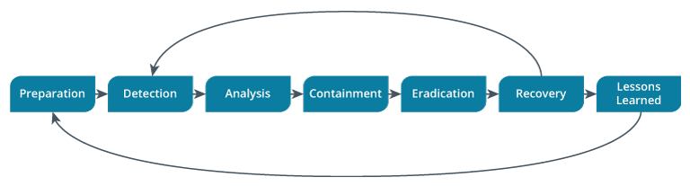
Incident Response Processes
Notes:
Incident response is discussed in Network+ now, but make sure you allow time to recap on the basic processes.
Note that there are several different models for this process, some of which conflate the tasks into fewer steps.

Slide 5
Preparation (1)
Cybersecurity infrastructure
Cyber Incident Response Team
  Reporting, categorizing, and prioritizing (triage)
  CIRT/CERT/CSIRT/SOC
  Management/decision-making authority
  Incident analysts
  Roles beyond technical response
    Legal, Human Resources (HR), Marketing

Slide 6
Preparation (2)
Communication plan
  Prevent inadvertent disclosure
  Call list identifying trusted parties
  Share data on a need to know basis
  Out-of-band communications—avoid alerting intruder
Stakeholder management
  Communication with internal and external stakeholders
  Notification and reporting
Incident response plan (IRP)

Slide 7
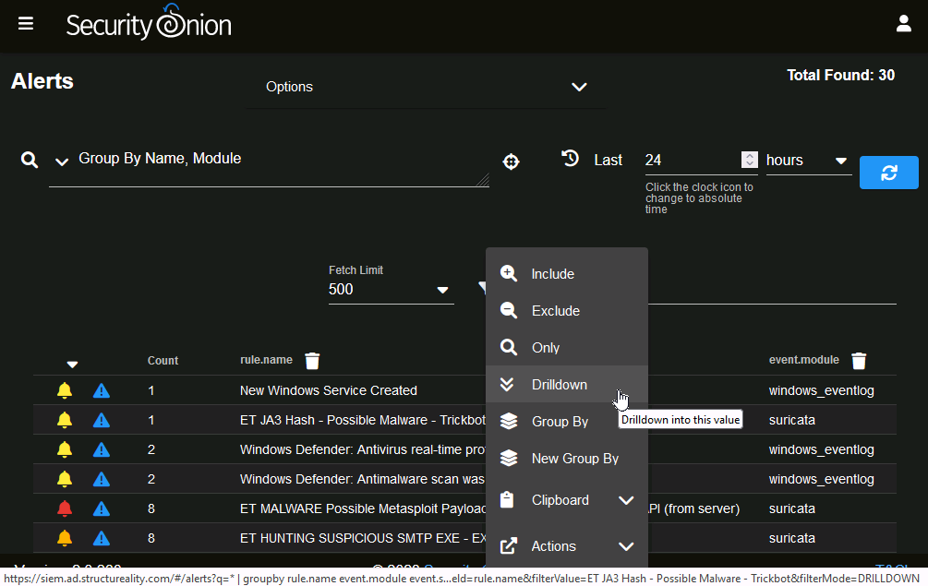
Detection
Detection channels
  Monitoring and alerting from logs and other data sources
  Deviation from baseline metrics
  Manual inspection
  Notification procedures
  Public reporting and whistleblowing
First responder
  Member of CIRT taking charge of a reported incident
Notes:
Make sure students understand the "day-to-day" of incident identification and alerting.
Point out that there are multiple models for incident response with between four and seven steps or stages. CompTIA's model distinguishes detection and analysis. Given that, detection involves how the first responder becomes aware that an incident may be occurring (or about to occur). This could come from an alerting/monitoring system or via user reports.

Slide 8
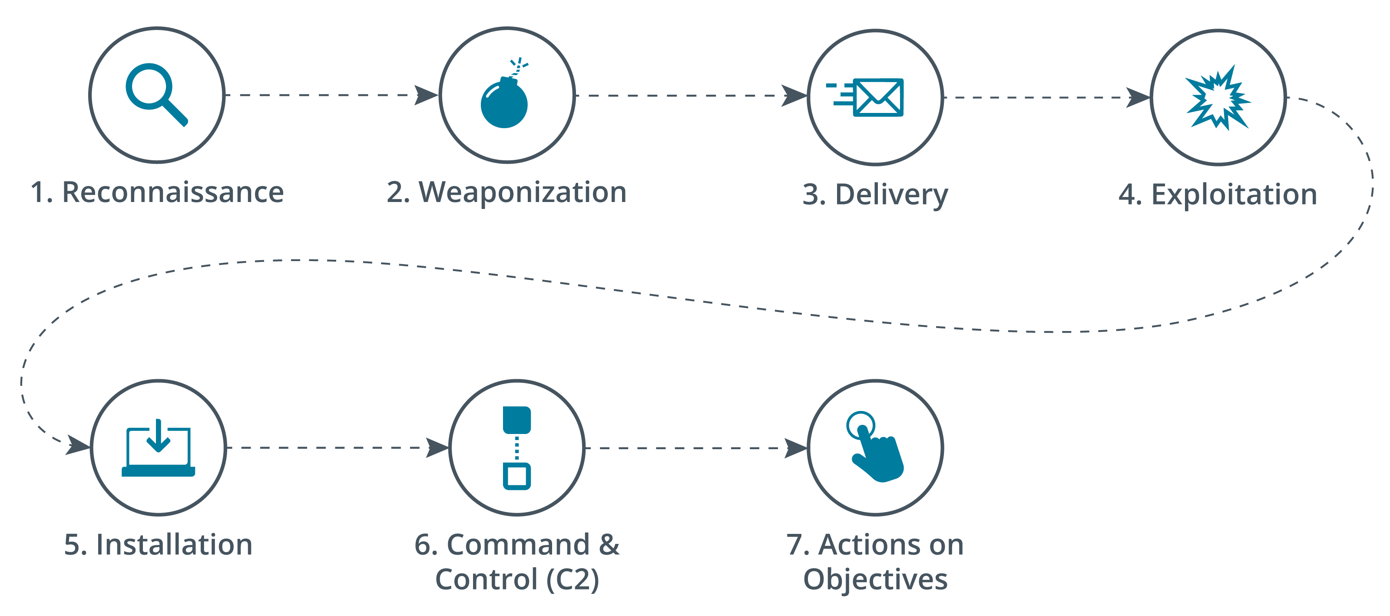
Analysis
Analysis and incident identification
  Classify and prioritize
  Downgrade low priority alerts to log-only
Impact
  Data integrity, downtime
  Economic/publicity
  Scope
  Detection time, recovery time
Category
  Kill chains and threat intelligence
Playbooks
Notes:
Relate the use of attack frameworks to the creation of effective scenario-based incident response plans.
Note that analysis and detection are likely to be iterative: analysis leads to detection of other indicators and potentially wider scope and impact.

Slide 9
Containment
Issues
  Loss control
  Countermeasures available
  Preserving evidence
Isolation-based containment
Segmentation-based containment
Notes:
Note that containment strategies can be influenced by the need to preserve forensic evidence.

Slide 10
Eradication and Recovery
Reconstitution of affected systems
Reaudit security controls
Ensure that affected parties are notified

Slide 11
Lessons Learned
Meet and report
Root cause analysis
  Five whys
  Drill through incident with questions: Who, why, when, where, how, what
  Walkthrough timeline

Slide 12
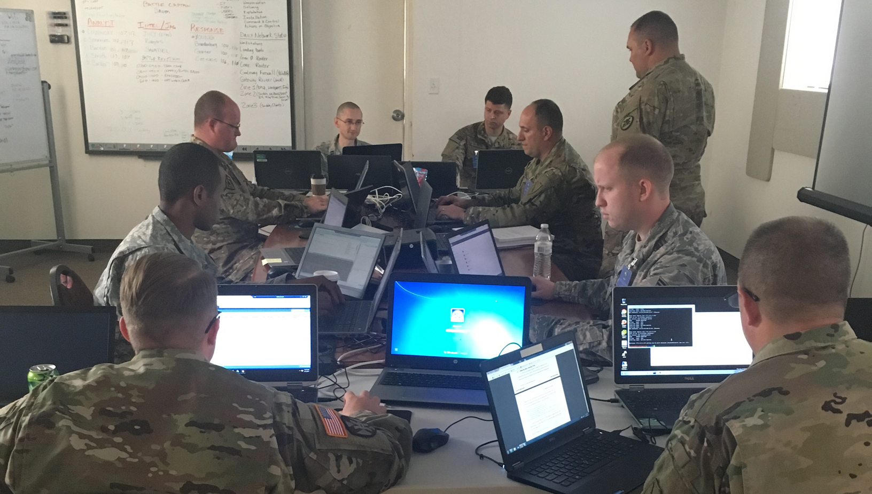
Testing and Training
Testing
  Tabletop
    Facilitator presents a scenario
    Does not involve live systems
  Walkthroughs
    Responders demonstrate response actions
  Simulations
    Red team performs a simulated intrusion
Training
Members of the Kentucky and Alabama National Guard participate in a simulated network attack exercise.
(Photo by Kentucky National Guard Maj. Carla Raisler.)

Slide 13
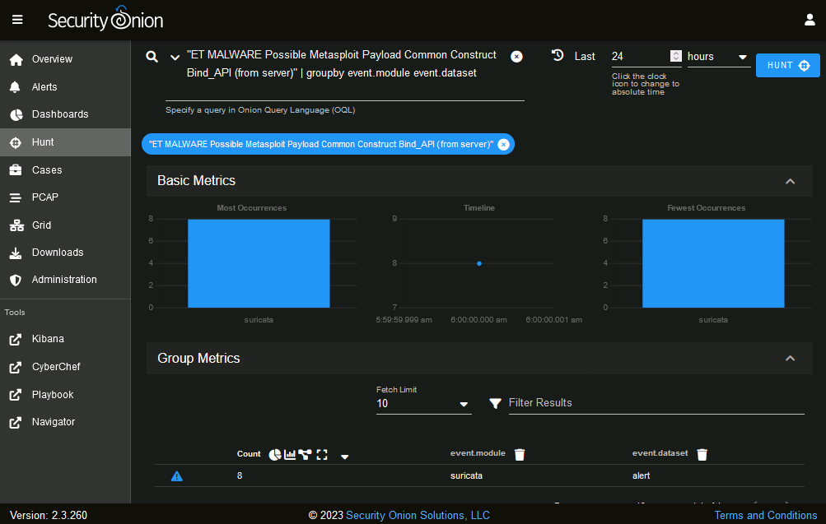
Threat Hunting
Proactive process compared to reactive incident response
Warning of new threat types
Intelligence fusion and threat data
Maneuver
  Awareness that threat actor might take countermeasures
The Hunt dashboards in Security Onion can help to determine whether a given alert affects a single system only (as here), or whether it is more widespread across the network. (Screenshot courtesy of Security Onion securityonion.net.)
Notes:
We haven't discussed penetration testing yet, but you might want to draw a distinction with threat hunting here. Both are proactive, compared to the reactive IR function. Penetration testing assesses the security of an attack surface by adopting the mindset and tools of threat actors. Threat hunting is a "deep dive" into data sources to check for indicators that might not have been surfaced as alerts.

Slide 14
Incident Response
Incident response processes
  Preparation
  Detection
  Analysis
  Containment
  Eradication
  Recovery
  Lessons learned
Testing and training
Threat hunting

Slide 15
Digital Forensics
Lesson 12
Topic 12B
Notes:
Forensics follows on from incident response, but note the difference in approach related to the importance of preservation of evidence.

Slide 16
Due Process and Legal Hold
Digital forensics
  Collecting evidence from computer systems to a standard that will be accepted in a court of law
Evidence, documentation, and admissibility
  Latent evidence
  Collection must be documented
Due process
  Evidence collection and analysis procedures that ensure fairness
Legal hold
  Right to seize systems as evidence
Notes:
Discuss why digital forensics techniques might be used even if no criminal prosecution is planned. Stress that the same standards of evidence collection must be applied, even if the investigation is a purely internal one.

Slide 17
Acquisition
Legal seizure and search of devices
Computer on/off state
Order of volatility
  CPU registers, cache memory, and non-persistent system memory (RAM)
  Data on persistent storage
  Remote logging and monitoring data
  Physical configuration and network topology
  Archival media
Notes:
In practical terms, CPU registers and cache aren't accessible as sources of forensics evidence, but advise students to learn the full order regardless.
Note that there are a lot of different kinds of cache.

Slide 18
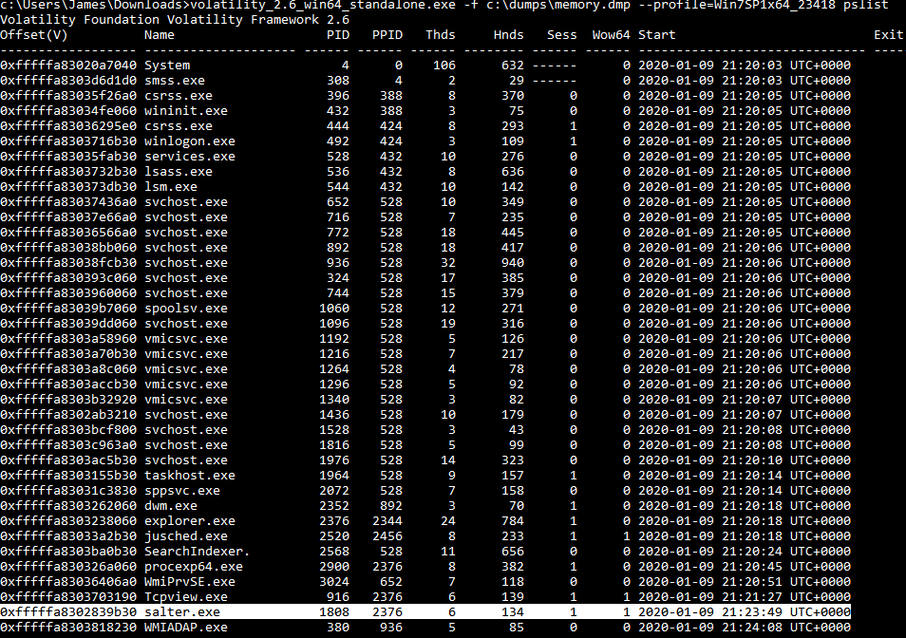
System Memory Acquisition
Evidence recovery from non-persistent memory
  Contents of temporary file systems, registry data, network connections, cryptographic keys, …
Live acquisition
  Pre-install kernel driver
Screenshot: Volatility Framework volatilityfoundation.org.)
Notes:
Remind students that there is no physical evidence to validate a system memory image, so the provenance of the capture can only be established by video recording the process.
Note that one of the functions of EDR is to perform live memory capture when suspicious activity is detected.

Slide 19
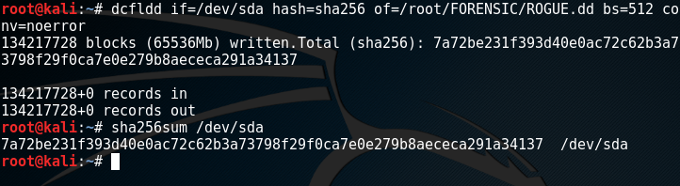
Disk Image Acquisition
Non-volatile storage media and devices
Acquisition types
  Live acquisition
  Static acquisition by shutting down the host
  Static acquisition by pulling the plug
Imaging utilities
  Forensic software suites and file formats
Using dcfldd (a version of dd with additional forensics functionality created by the DoD) and generating a hash of the source-disk data (sda).
Notes:
Note that imaging tools make bit-level copies of the media. They do not use the OS file system to mediate access. This allows them to capture artifacts that may be hidden from the file system.

Slide 20
Preservation
Timeline and provenance
  Record process of evidence acquisition
  Use a write blocker
Evidence integrity and non-repudiation
  Cryptographic hashing and checksums
  Take hashes of source device, reference image, and copy of image for analysis
Chain of custody
  Integrity and proper handling of evidence from collection, to analysis, to storage, and finally to presentation
  Secure tamper-evident bagging
  Secure storage facility and protection against environmental hazards
Notes:
If necessary, remind students how cryptographic hash functions prove integrity.

Slide 21
Reporting
Summarizes contents of the digital data
Conclusions from the investigator's analysis
Professional ethics
  Analysis must be performed without bias
  Analysis methods must be repeatable
  Evidence must not be changed or manipulated
E-discovery
  Electronically Stored Information (ESI)
  Identify and de-duplicate files and metadata and facilitate search and tagging
  Protect access and make tamper-evident
  Facilitate disclosure

Slide 22
Digital Forensics
Due process and legal hold
Acquisition
  Order of volatility
System memory acquisition
Disk image acquisition
Preservation
  Evidence integrity, reference hash, chain of custody
Reporting
  E-discovery

Slide 23
Data Sources
Lesson 12
Topic 12C
Notes:
This topic covers the sources of data that are likely to contain indicators, and so support incident response and security monitoring.

Slide 24
Data Sources, Dashboards, and Reports (1)
System memory and media device file system data and metadata
Log files generated by network appliances
Network traffic captured by sensors and/or intrusion detection systems
Log files and alerts generated by network-based vulnerability scanners
Log files generated by the OS components of client and server hosts
Log files generated by applications and services running on hosts
Log files and alerts generated by endpoint security software installed on hosts
Notes:
We'll revisit SIEM in more detail in the next topic.

Slide 25
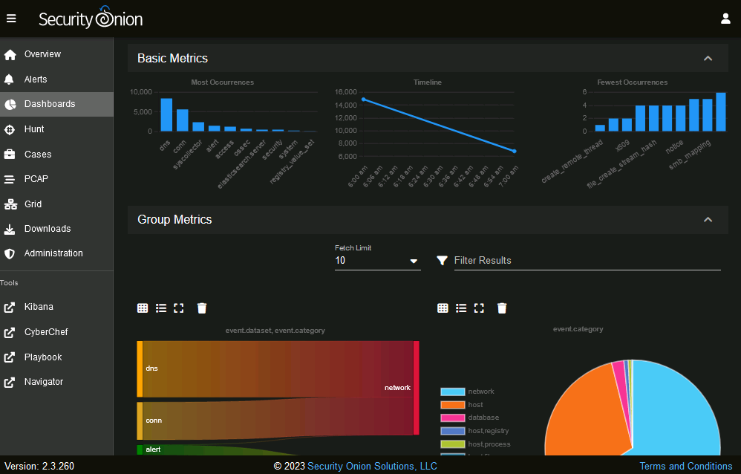
Data Sources, Dashboards, and Reports (2)
Analyst dashboard
  Console of alerts that require prioritization and investigation
Manager dashboard
  Overall status indicators
Automated reports
  Alerts and alarms
  Status reports for response team, business managers, business owners, and compliance
Screenshot courtesy of Security Onion (securityonion.net.)

Slide 26
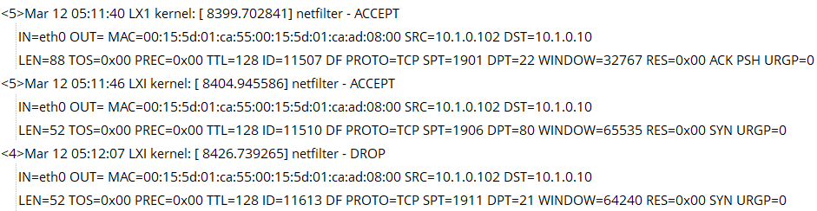
Log Data
Event
  Format and source (local or redirected over network)
  Event data versus metadata
Windows Event Viewer
Syslog
  PRI – facility and severity
  Header with timestamp and host
  Message part
Notes:
Focus on syslog, but make sure students recognize the difference in the alternative platforms.

Slide 27
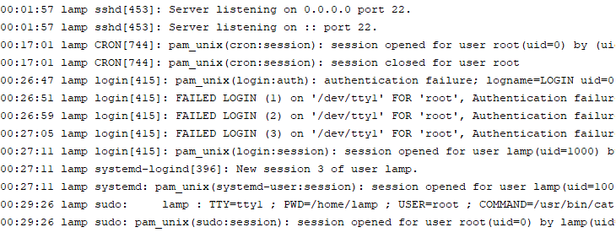
Host Operating System Logs
Security/audit logs
  Authentication and authorization events
  File system events
Windows
  Application, security, and system
Linux
  Syslog versus Journald
  Common log files
macOS unified logging
Linux authentication log showing SSH remote access is enabled, failed authentication attempts for root user, and successful login for lamp user.
Notes:
Emphasize that relying on the default logging options is unlikely to be sufficient. Audit logs in particular require careful tuning to provide an effective audit trail and enforce accountability and non-repudiation.
Auditing modern threats involves detailed logging of process creation and script execution.

Slide 28
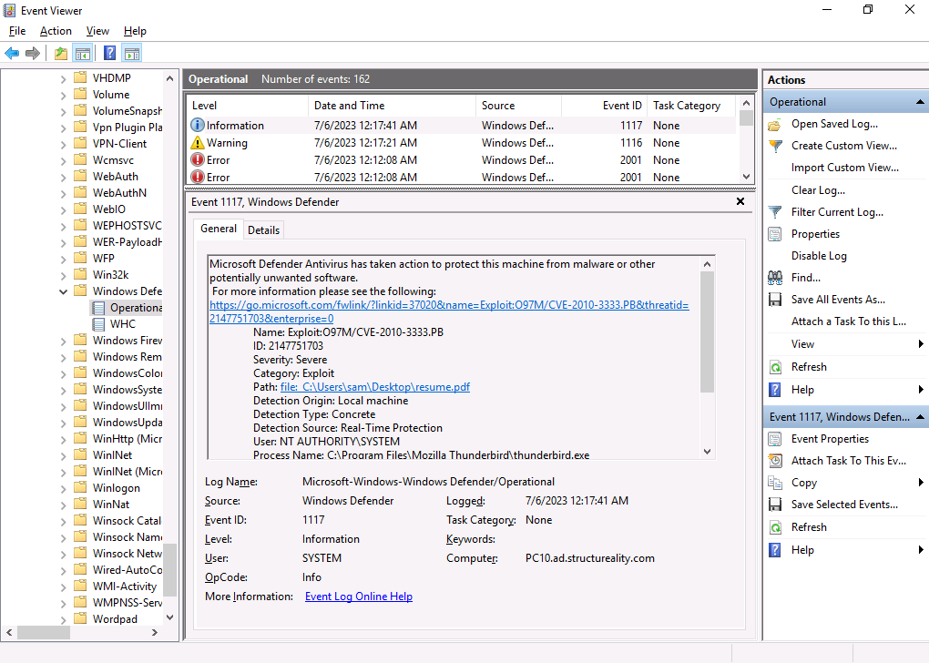
Application and Endpoint Logs
Application logs
Endpoint logs
  Security software running on hosts
  Summarize volume of detection incidents to indicate threat levels
  Incident attribution and threat intelligence
Vulnerability scans
Windows Defender logging detection and quarantine of malware to Event Viewer. (Screenshot used with permission from Microsoft.)
Notes:
You might want to note that sysmon is very widely used for Windows security logging (github.com/SwiftOnSecurity/sysmon-config).

Slide 29
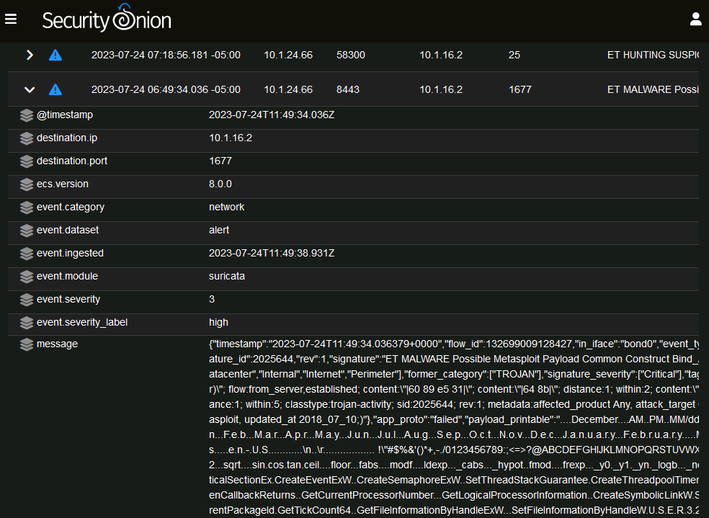
Network Data Sources
Network logs
  Traffic and access data from network appliances
Firewall logs
  Correlate to malicious activity on hosts
IPS/IDS logs
  Summarize volume of detection incidents to indicate threat levels
  Attribution and threat intelligence
Viewing the raw log message generated by a Suricata IDS alert in the Security Onion SIEM.
Notes:
You don't need to go through these in detail in class. Just make sure students know what type of information can be retrieved from each type of data source.

Slide 30
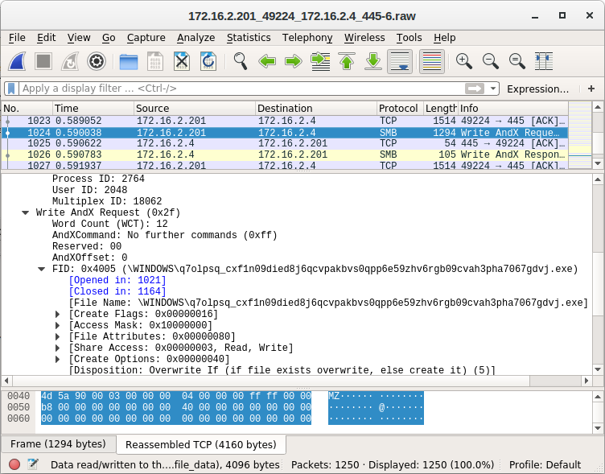
Packet Captures
Pivot from alert event to per-packet or frame analysis
Extract binary data
Using the Wireshark packet analyzer to identify malicious executables being transferred over the Windows file-sharing protocol. (Screenshot Wireshark wireshark.org.)

Slide 31
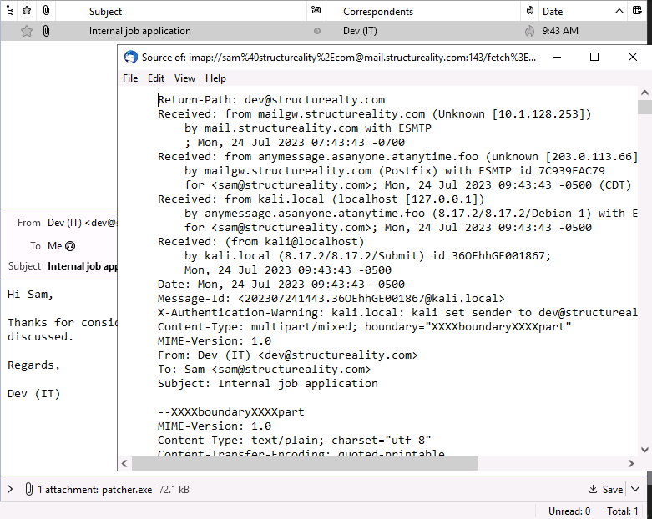
Metadata
File
  Date/time and security attributes
  Extended attributes and properties
Web
  Request and response headers
Email
  Internet header listing message transfer agents
  Spam/security analysis
Analyzing headers in a phishing message: the sender is using typosquatting to hope the recipient confuses structureality.com with the genuine domain structureality.com. (Screenshot courtesy of Mozilla.)
Notes:
While metadata is treated as a sub-bullet of log data in the exam objectives, it is probably worth mentioning these other metadata sources, as they are frequently called upon in IR and forensics investigations.

Slide 32
Data Sources
Data sources, dashboards, and reports
Log data
Host operating system logs
Application and endpoint logs
Network data sources
  Network appliance logs, firewall logs, IPS/IDS logs
Packet captures
Metadata

Slide 33
Applied Lab: Using Network Sniffers

Slide 34
Alerting and Monitoring Tools
Lesson 12
Topic 12D
Notes:
This topic focuses on SIEM, but note that using individual tools can sometimes be as effective.
Students don't need to implement SIEM, but they do need to be aware of general collection and correlation methods. Focus on general usage, and usability issues, such as alert fatigue.

Slide 35
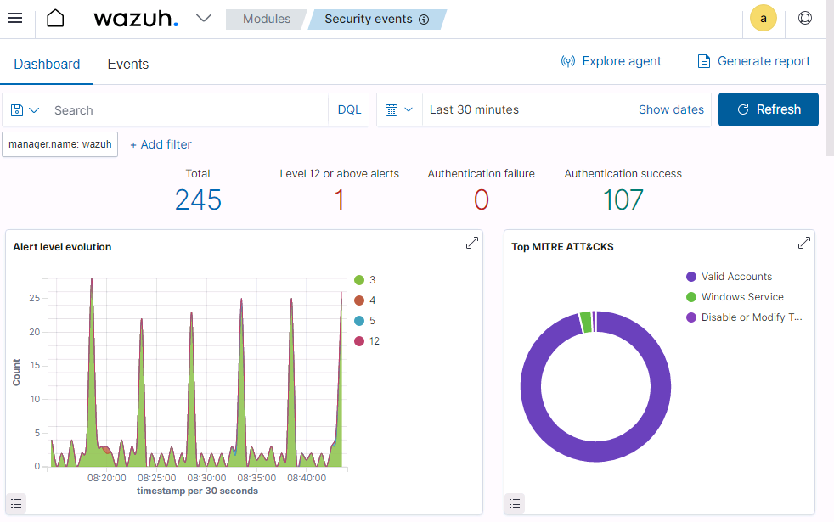
Security Information and Event Management
Log collection
  Agent-based
    Local agent to forward logs
  Listener/collector
    Protocol-based remote log forwarding (syslog)
  Sensor
    Packet capture and traffic flow data
Log aggregation
  Consolidation of multiple log formats to facilitate search/query and correlation
  Normalization of fields
  Time synchronization
Wazuh SIEM dashboard—Configurable dashboards provide the high-level status view of network security metrics. (Screenshot used with permission from Wazuh Inc.)
Notes:
Point out the difference between agent/collector/sensor placement and the location of the correlation and reporting server.

Slide 36
Alerting and Monitoring Activities
Alerting and correlation
  Static rules and logical expressions
  Threat intelligence feeds
  Validation of alerts as true positives versus false positives
  Quarantine for remediation
Reporting
  Executive, managerial, and compliance audiences
Archiving
  Preserve evidence of attack
  Facilitate threat hunting and retrospective incident identification

Slide 37
Alert Tuning (1)
Correlation action to log only, trigger alert, or trigger alarm
Reduce false positives without increasing false negatives
  False positives raise an alert when there is no actual malicious activity
  False negatives do not raise an alert when there is malicious activity
  True positives measure successful detection of incidents

Slide 38
Alert Tuning (2)
Techniques for tuning
  Refining detection rules and muting alert levels
  Redirecting sudden alert “floods“
  Redirecting infrastructure-related alerts
  Continuous monitoring of alert volume and analyst feedback
  Deploying machine learning (ML) analysis

Slide 39
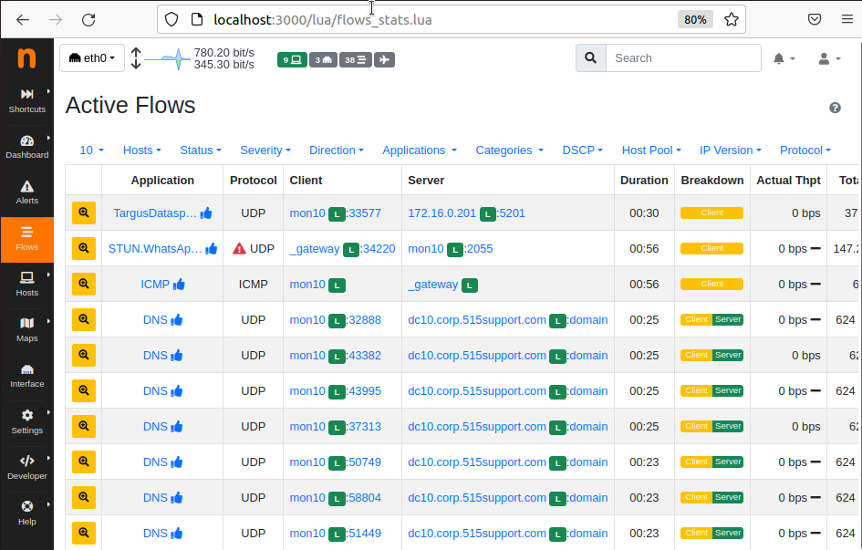
Monitoring Infrastructure
Network monitors
  Appliance state data
  Heartbeat availability monitoring
  Simple Network Management Protocol (SNMP) traps
Netflow/IPFIX
  Records traffic statistics
  Flows defined by endpoints and ports (keys)
  Netflow exporters and collectors
ntopng community edition being used to monitor NetFlow traffic data. (Screenshot used courtesy of ntop.)
Notes:
Remind students that we have covered a lot of the main data sources for alerting and monitoring in the previous topic. The next few pages summarize the type of data found in subobjectives that are part of 4.4 (security and alertingmonitoring concepts) that were not included under 4.9 (data sources to support an investigation).

Slide 40
Monitoring Systems and Applications
System monitors and logs
  System health reporting
  System logs to diagnose availability issues
  Security logs to audit access
Application and cloud monitors
  Application health monitoring
  Cloud service health
Vulnerability scanners
Antivirus
Data loss prevention (DLP)
Notes:
We've already covered vulnerability scanning and endpoint protection, so just summarize these as potential sources
DLP is covered in more detail with data protection and privacy concepts in lesson 16.
You can use a down detector site to illustrate the basic function of application monitoring.

Slide 41
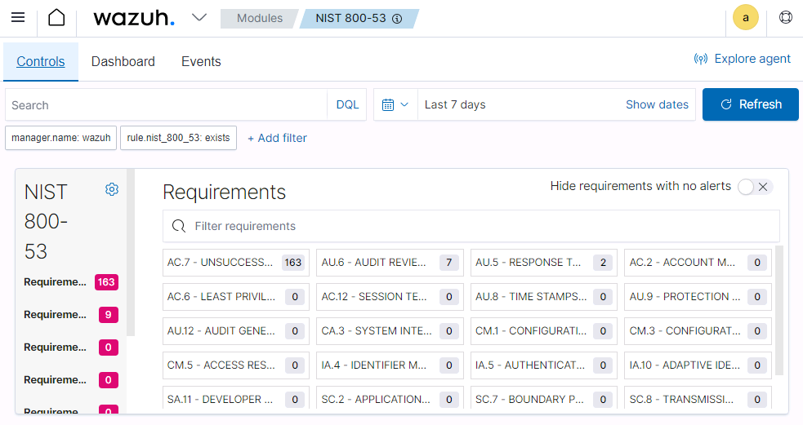
Benchmarks
Scanning for configuration vulnerabilities
  Lack of controls
  Improper configuration
Security content automation protocol (SCAP)
  Language to enable scanners to load configuration benchmarks and scan for deviations
Monitoring template aligned to NIST 800-53 framework requirements.

Slide 42
Alerting and Monitoring Tools
Security Information and Event Management
  Collection and aggregation
Alerting and monitoring activities
  Correlation, reporting, archiving
Alert tuning
  False positives, false negatives, alert fatigue
Monitoring infrastructure
  Network monitors, NetFlow
Monitoring systems and applications
Benchmarks
  SCAP, OVAL, XCCDF configuration baseline scanning

Slide 43
Summary
CompTIA Security+ Exam SY0-701
Lesson 12
Notes:
Check that students are confident about the content that has been covered. If there is time, revisit any content examples that they have questions about. If you have used all the available time for this lesson block, note the issues and schedule time for a review later in the course.
Use this as an opportunity for students to share their real-world experiences with day-to-day security challenges in terms of managing alerts and incidents.

